Slide 1

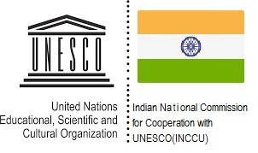


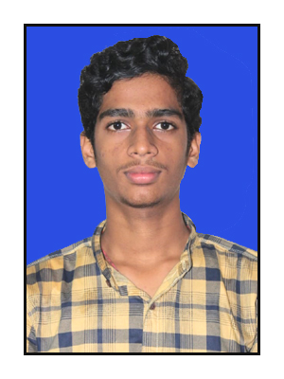
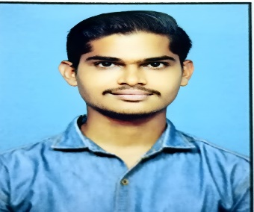
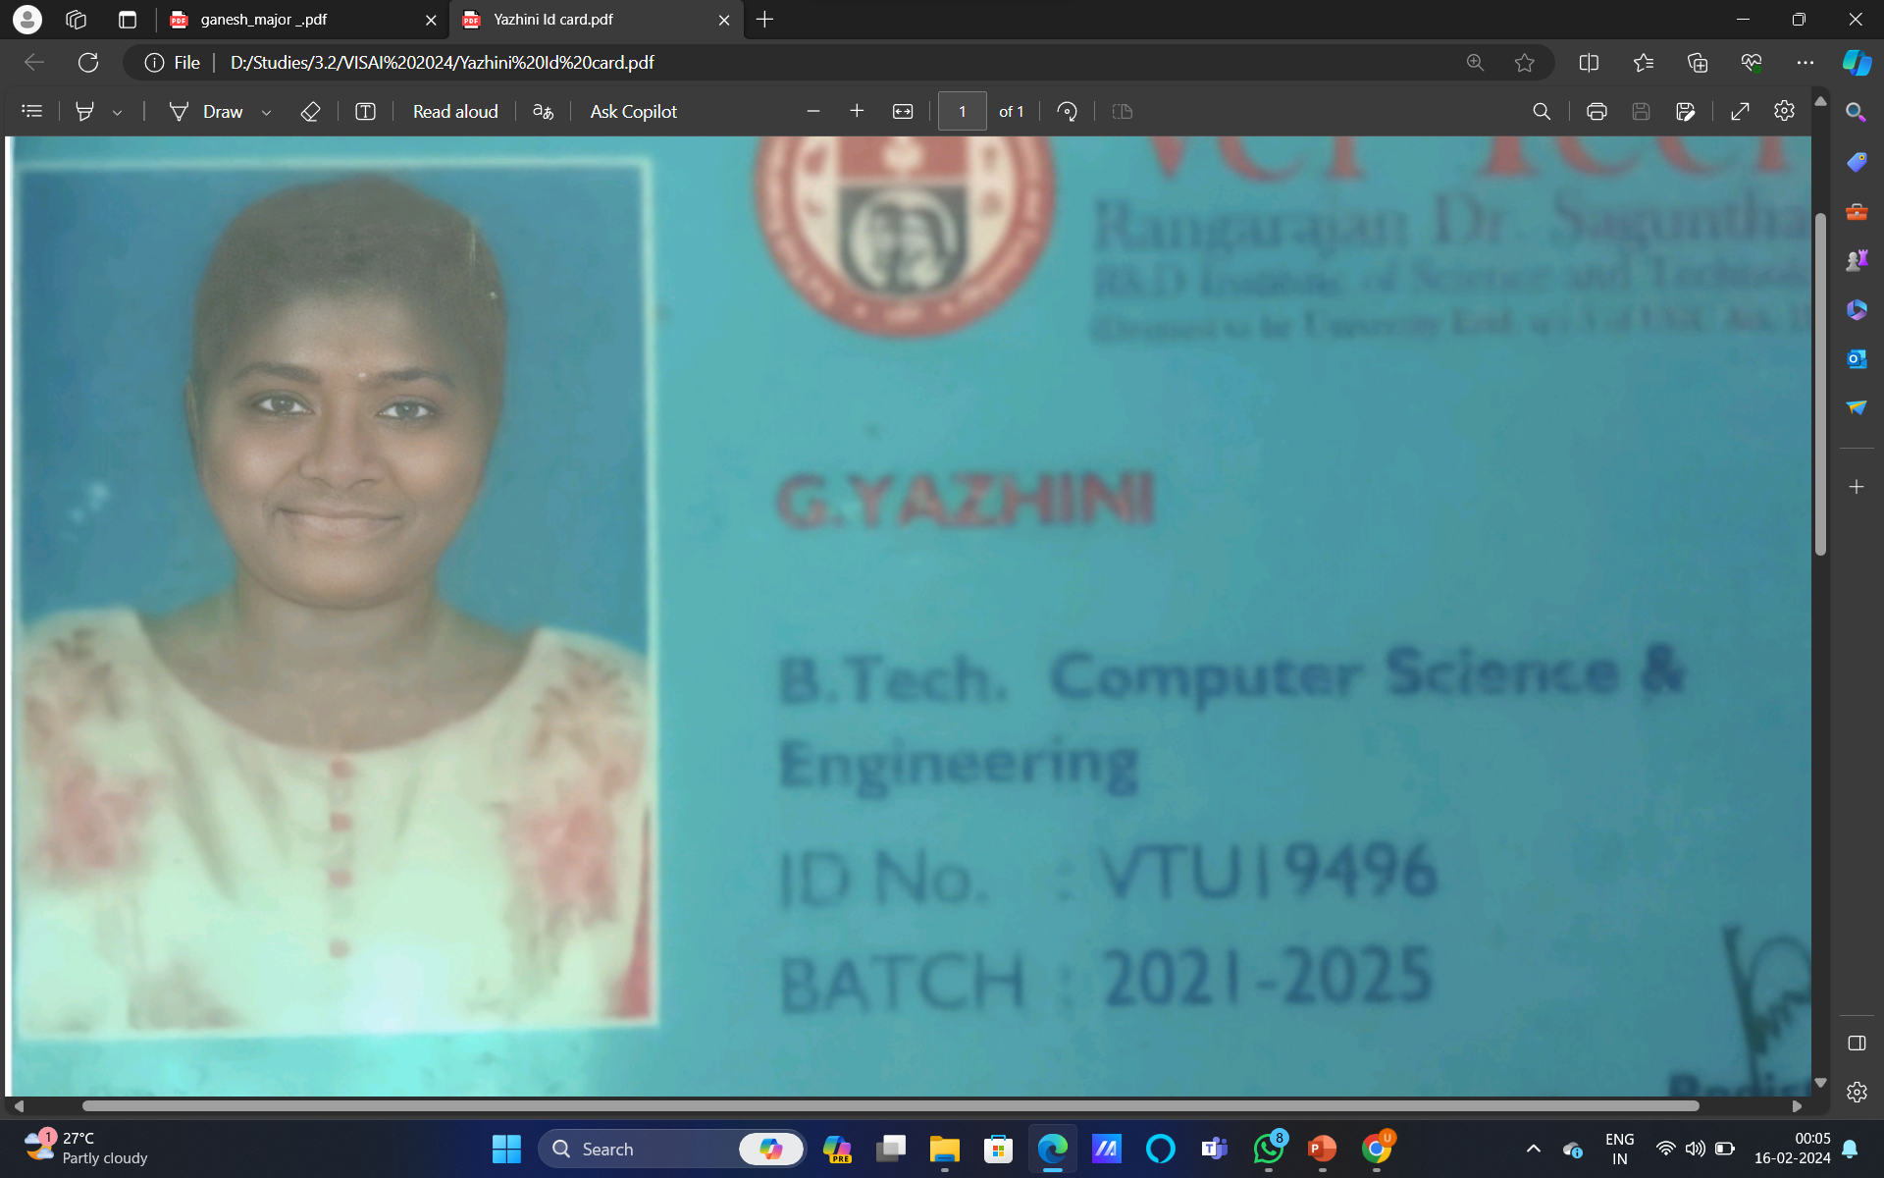

Joint Collaborative Event
14TH INTERNATIONAL PROJECT COMPETITION AND EXHIBITION 24.02.2024
IMAGE TRANSMISSION USING UNDER WATER WIRELESS OPTICAL COMMUNICATION
Photo
(Student 1)
M.Shanmukha mani
L.Pavan Kumar Reddy
G.Yazhini
College Name : VELTECH RANGARAJAN DR.SAGUNTHALA R&D INSTITUTE OF SCIENCE AND TECCHNOLOGY
Reference Number : 201384

Slide 2



Index
1
Project Details/Problem Statement
2
Concept of the Solution
3
Novelty / Scope of Solution
4
Pros and Cons of the solution
5
Technical Description
6
Implementation Plan or Working Model (as the case may be)
7
Validation/Testing/Analysis
8
Cost Estimate (If needed)
9
Assumptions(if any)
10
References

Slide 3

Problem Statement
In the realm of underwater communication, the conventional methods face formidable obstacles, primarily stemming from the limitations of radio frequency (RF) transmission and the inherent light attenuation in water. This project endeavors to devise a robust solution for transmitting images underwater by harnessing the potential of wireless optical communication. The challenge lies in mitigating signal degradation, distortion, and environmental interference while upholding swift data transfer rates and superior image fidelity. Moreover, the solution should remain economically viable, energy-efficient, and adaptable to diverse underwater applications, spanning from exploration to surveillance and communication.

Slide 4
Concept of the solution
Crafting a breakthrough solution, our focus lies on pioneering a holistic system tailored for transmitting images beneath the waves through wireless optical communication. Central to our endeavor is the creation of an adept optical transmitter, adept at seamlessly converting digital image data into subaquatic-friendly optical signals, complemented by a sophisticated receiver fortified with cutting-edge signal processing algorithms. Essential to our approach is an intricate understanding of the nuanced optical propagation dynamics underwater, guiding the refinement of modulation schemes and signal processing methodologies. Rigorous validation, spanning from controlled laboratory simulations to real-world field trials, will underscore the system's prowess, gauging its prowess across metrics including data throughput, image integrity, and operational robustness. As we navigate towards integration, envision a realm where underwater exploration, surveillance, and environmental monitoring flourish with newfound clarity, propelled by the transformative potential of wireless optical communication tailored to the depths

Slide 5
Novelty / Scope of Solution
Our innovation merges wireless optical communication with underwater imaging, departing from RF limitations. Specialized hardware and advanced algorithms optimize data transmission. This novel approach promises unparalleled clarity and reliability in underwater environments, unlocking new possibilities for exploration, surveillance, and scientific research in the depths of our oceans. It includes developing compression methods suitable for optical channels, adapting modulation techniques to underwater conditions, and simulating channel behavior. Hardware solutions must address environmental factors like water turbidity and depth. Error correction and data recovery mechanisms ensure data integrity despite high error rates. Integration with applications such as surveillance and research ensures practical utility.

Slide 6
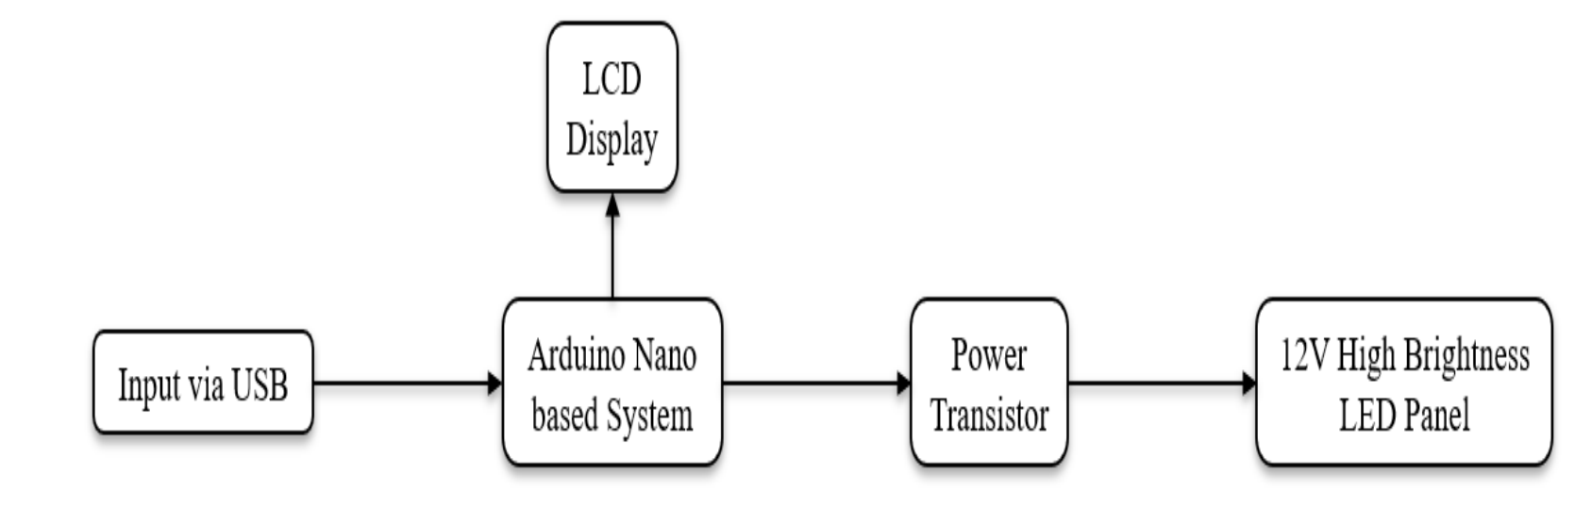
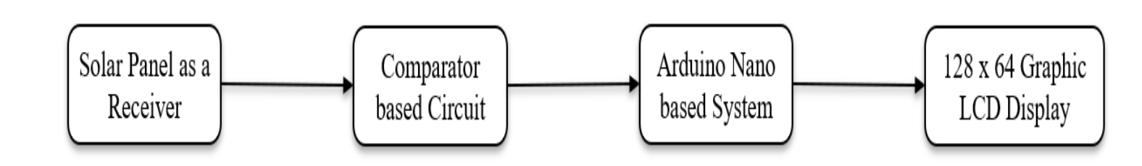
Technical Description
The transmitter section comprises a keyboard connected with a PS2 connector and interfaced directly with microcontroller IC AT89S52. IC AT89S52 also referred to as 8051, is a 40 pin IC, used to provide serial data communication. A crystal oscillator with a frequency of 11.0592 Mhz is used to provide the desired clock frequency to the microcontroller for its working. T
a)Transmitter
The receiver section comprises a photodiode connected to the PNP transistor (IC BC 5578). A 9v battery is attached to the circuit to provide the power supply. A voltage regulator IC 7805 is used to step down the 9v dc supply to 5v dc supply for the working of the microcontroller AT89S52.
b) Reciever
Description:
Underwater wireless optical communication (UWOC) enables image transmission using light. LEDs or lasers encode data; photodetectors capture signals. UWOC revolutionizes underwater data transfer, promising speed and reliability

Slide 7
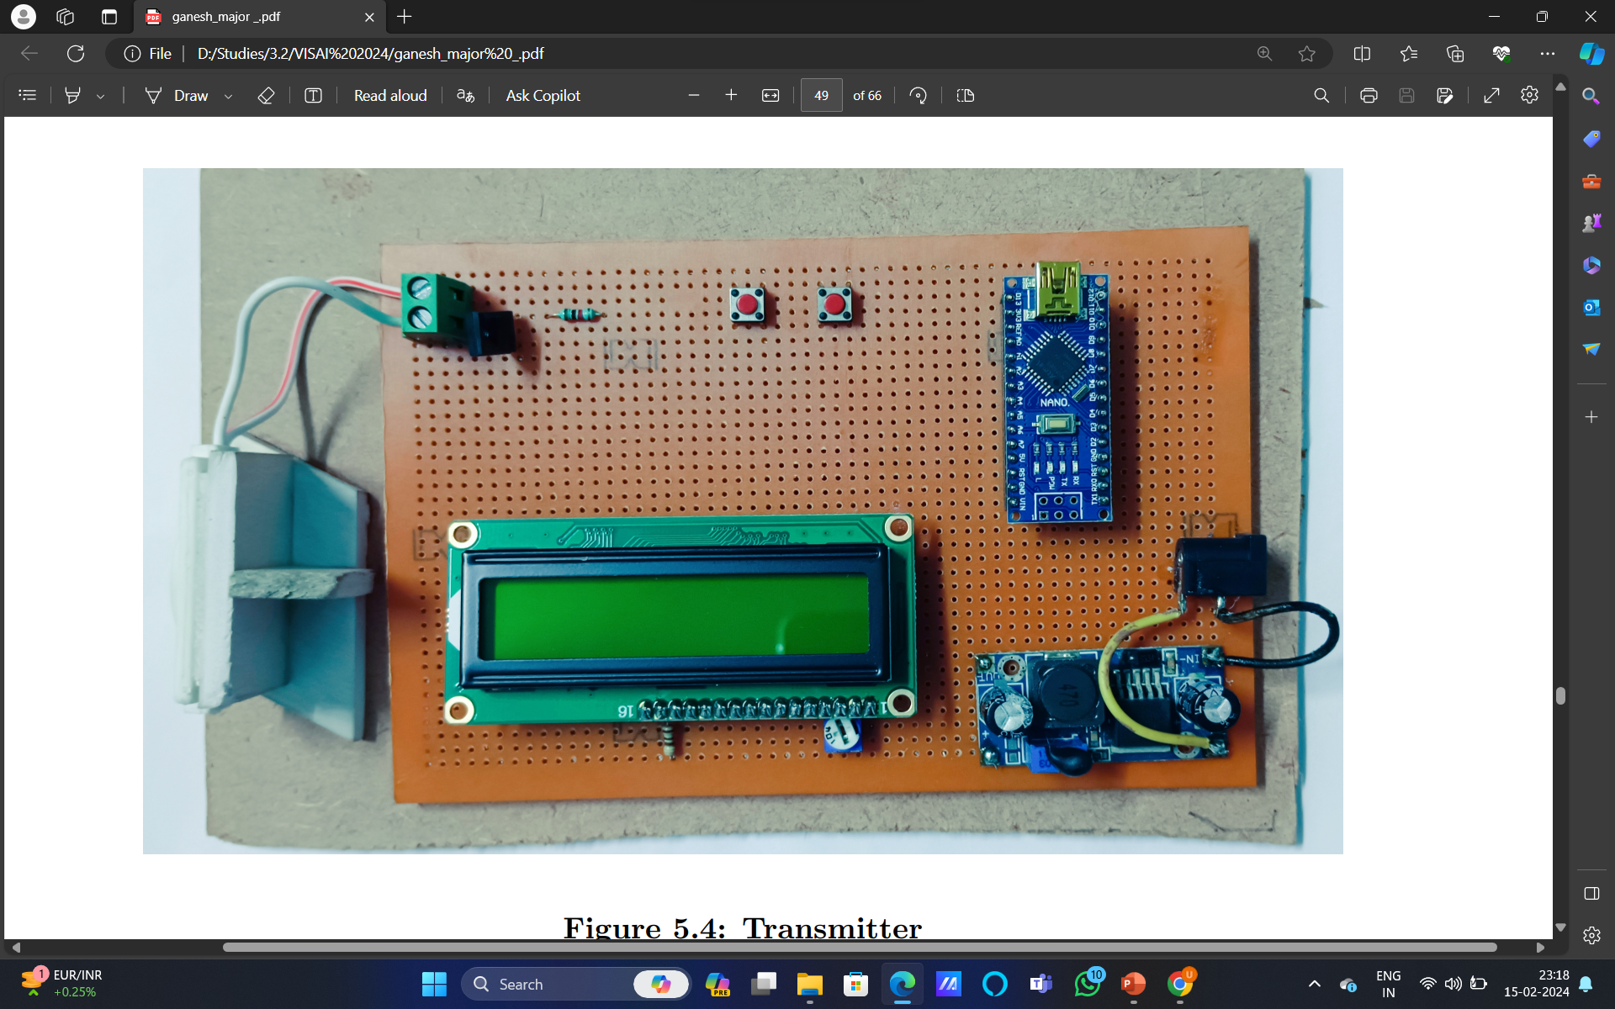
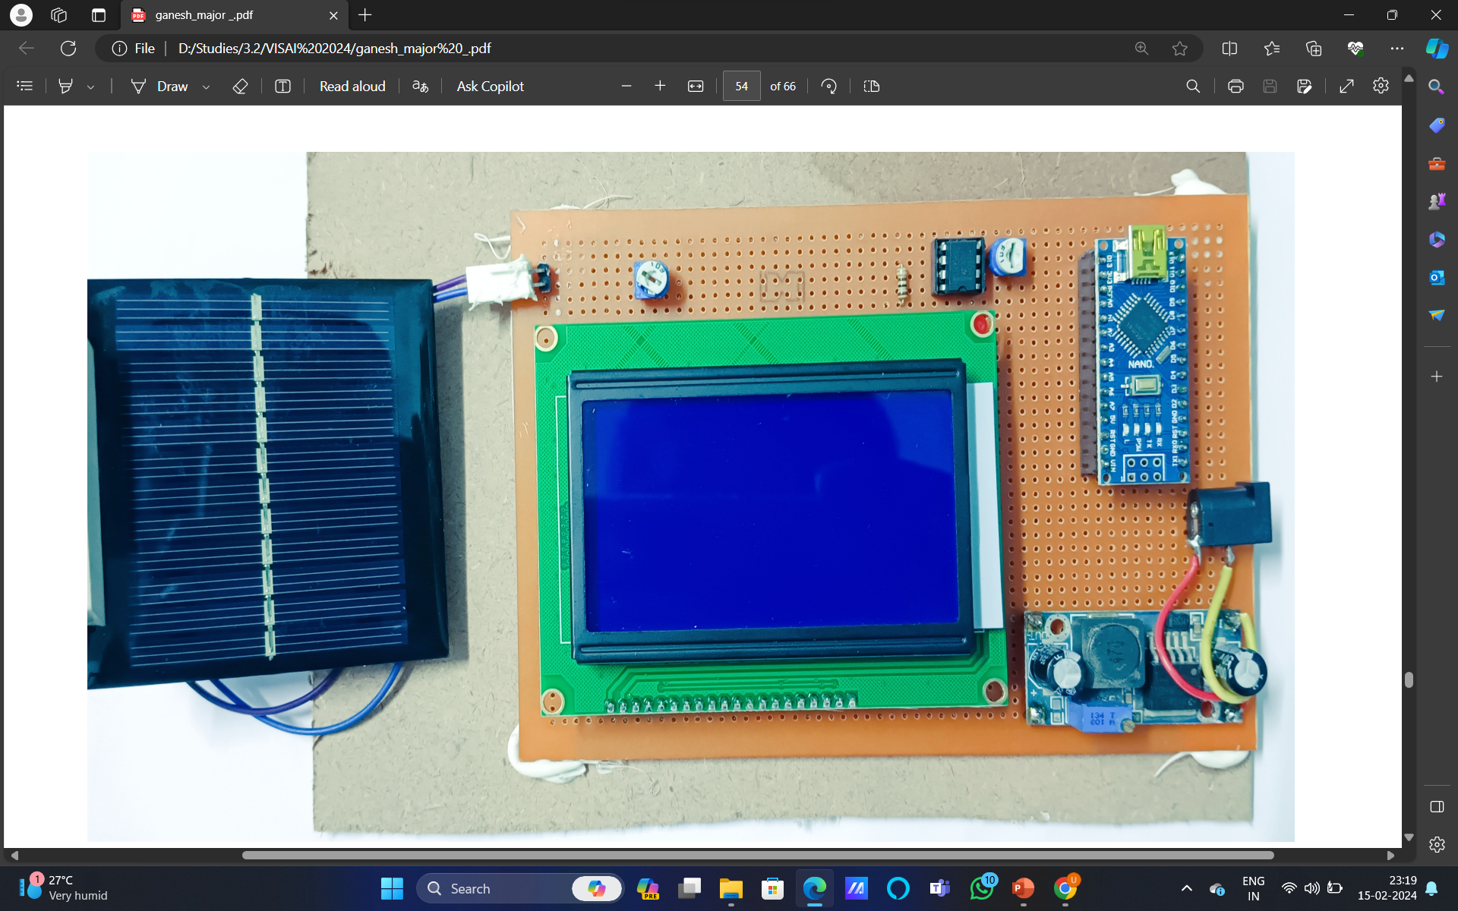
Implementation Plan/Working Model
Transmitter
Reciever
Working:
Optical underwater communication provides great potential to augment traditional acoustic communication due to its high data rates, low latency, less power consumption and smaller packaging. Also, this technology can benefit meaningfully from the progress made in the terrestrial optical wireless communication

Slide 8
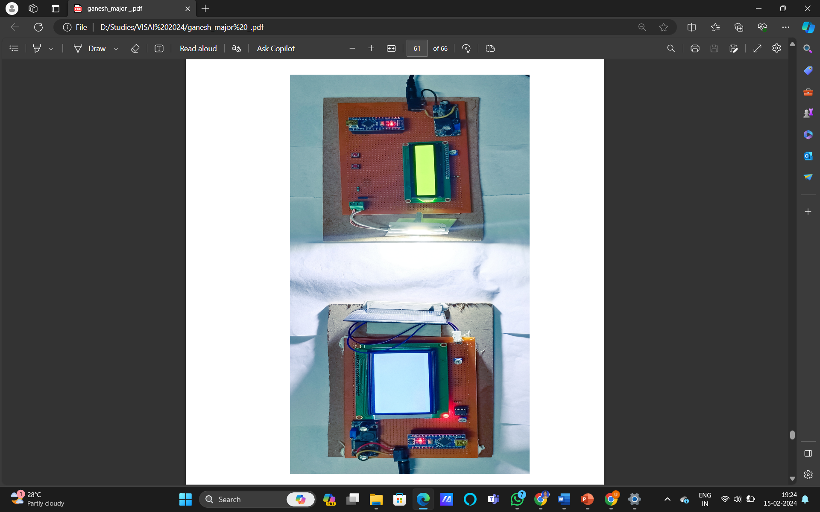
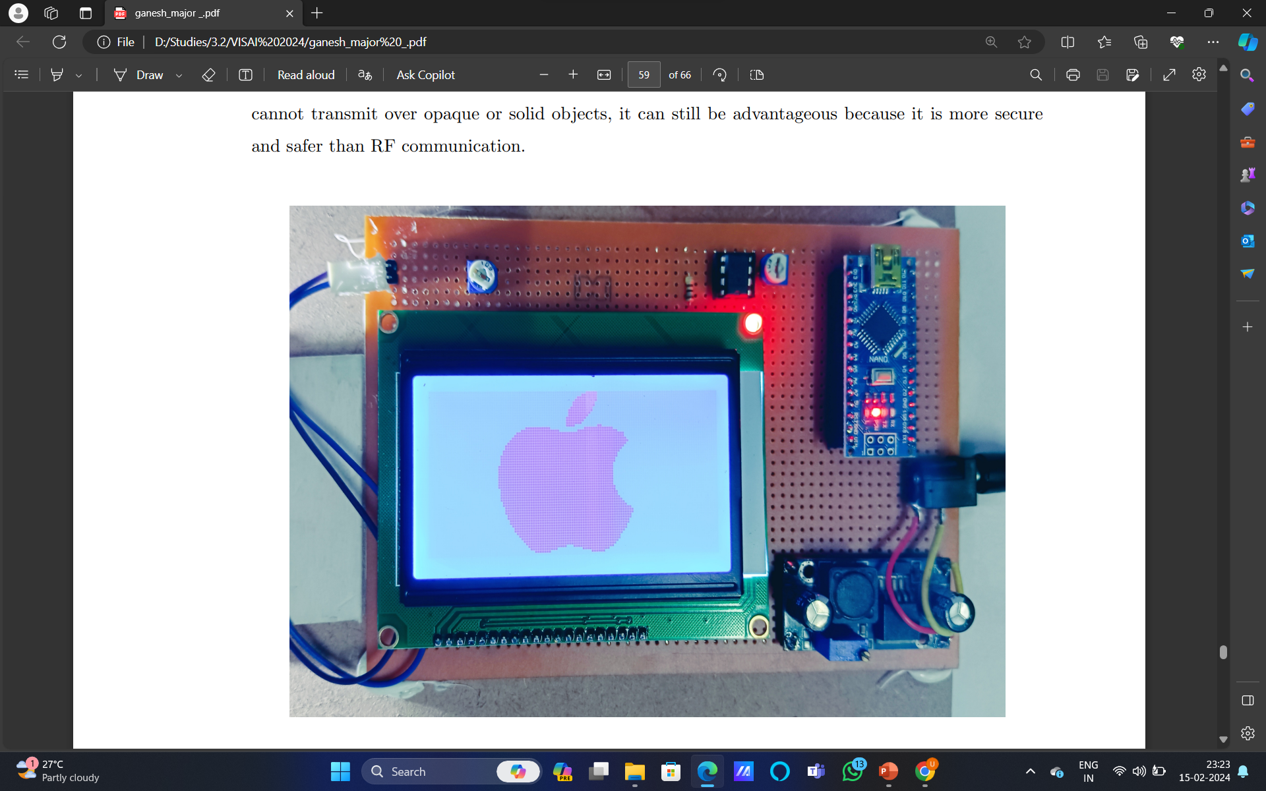
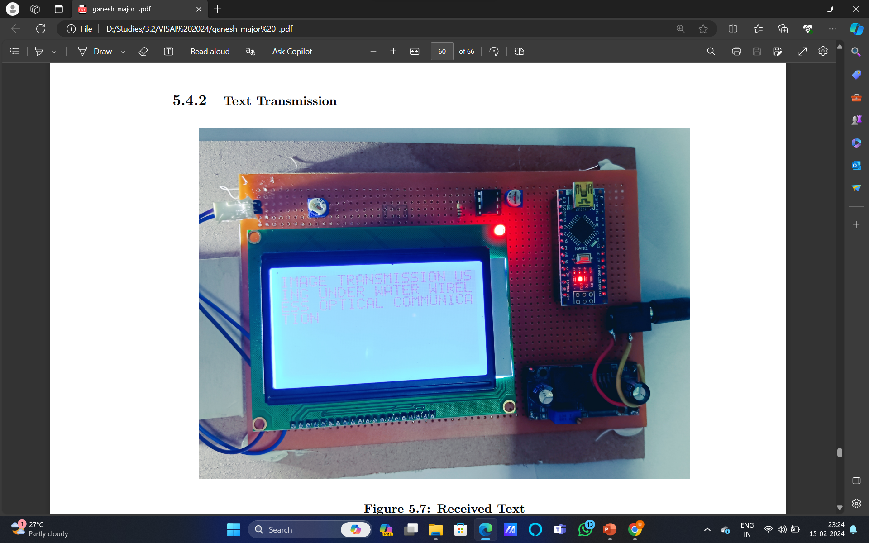
Validation / Testing / Analysis
Output : Received Image and Text
Working Model

Slide 9
Cost Estimate(if required)
S.no | Component | Quantity | Price
1 | Arduino Nano Board
2 | Laser Driver & Source
3 | Photo Detector
4 | Amplifier
5 | Modulator
6 | Demodulator

Slide 10
Pros and Cons of the solution
Pros | Cons
High Data Rates(10’s of Kilobits Per Second) | Limited Range
Reduced Latency(Light signals travel at the speed of light) | Environmental Sensitivity(water temperature, salinity, and ambient light levels)
Less Interference | Line-of-Sight Requirement
Enhanced Security | Cost and Complexity
Versatility | Power Consumption

Slide 11
References
1] Lin, Aobo, Zheng Tong, Yuhang Song, Meiwei Kong, and Jing Xu. ”Underwater wireless optical communication system using blue LEDs.” In Journal of Physics: Conference Series, vol. 679, no. 1, p. 012032. IOP Publishing, 2020.
[2] Schirripa Spagnolo, Giuseppe, Lorenzo Cozzella, and Fabio Leccese. ”Underwater optical wireless communications: Overview.” Sensors 20, no. 8 (2020): 2261.
[3] Wu, F.M., Lin, C.T., Wei, C.C., Chen, C.W., Chen, Z.Y., Huang, H.T. and Chi, S., 2020. Performance comparison of OFDM signal and CAP signal over high capacity RGB-LED-based WDM visible light communication. IEEE photonics journal, 5(4), pp.7901507-7901507.
[4] Anguita, Davide, Davide Brizzolara, and Giancarlo Parodi. ”Building an underwater wireless sensor network based on optical: Communication: Research challenges and current results.” In 2009 third international conference on sensor technologies and applications, pp. 476-479. IEEE, 2019.

Slide 12

THANK YOU

Slide 13
GUIDELINES
Not more than 12 slides
Do not give any theoretical fundamentals.
Illustrate with suitable means such as Drawings, examples, algorithms, flow chart etc
Use consistent format
Check for spelling and grammar – ensure no errors (spell check)
Highlight the major advantages of the technique/method proposed when compared with other techniques or conventional techniques
While uploading the PPT file, rename as VISAI Reference Number.

